Slide 1
Welcome!

Slide 2
Meeting the Needs of Seniors, Caregivers and Adults with Disabilities in Our Community
Notes:
Why is it important to know about us? (You encounter those who can benefit from the resources and information we can share with them)

Slide 3
Mission:
To empower people to live and age with independence and dignity in their homes and in their communities.
Provides information and referrals to community resources
The Area Agency on Aging & The Aging and Disability Resource Center
A non-profit organization funded by the Dept. of Elder Affairs, the Older Americans Act, and private grants and donations
Serves 7 counties (Duval, St. Johns, Baker, Clay, Nassau, Volusia, Flagler)

Slide 4
The Caregiver Coalition of Northeast Florida a program of ElderSource
Mission:
To elevate caregiving in Northeast Florida by providing resources and information.
Caregiver Coalition events occur 4 to 5 times per year
Events are both virtual and in-person
Events are always free of charge

Slide 5
Join us!
Quarterly newsletter
Facebook page
Website (caregivercoalition.org)
VISIT OUR RESOURCE TABLE TODAY!

Slide 6
Supporting Your Mental Health as You Care for Someone with Dementia

Slide 7
Our first speaker…
Sherri Cheshire, RRT, AE-C, CAPS Senior Program Training Coordinator Northeast Florida AHEC

Slide 8
Self-care Stress Management

Slide 9
Stress management
Signs and symptoms of caregiver stress
What does stress do to our body?
What does stress management do for us?
Tips to Manage Stress
Building a Time-for-Yourself Repertoire
Time is like money spend it well
Asking for help

Slide 10
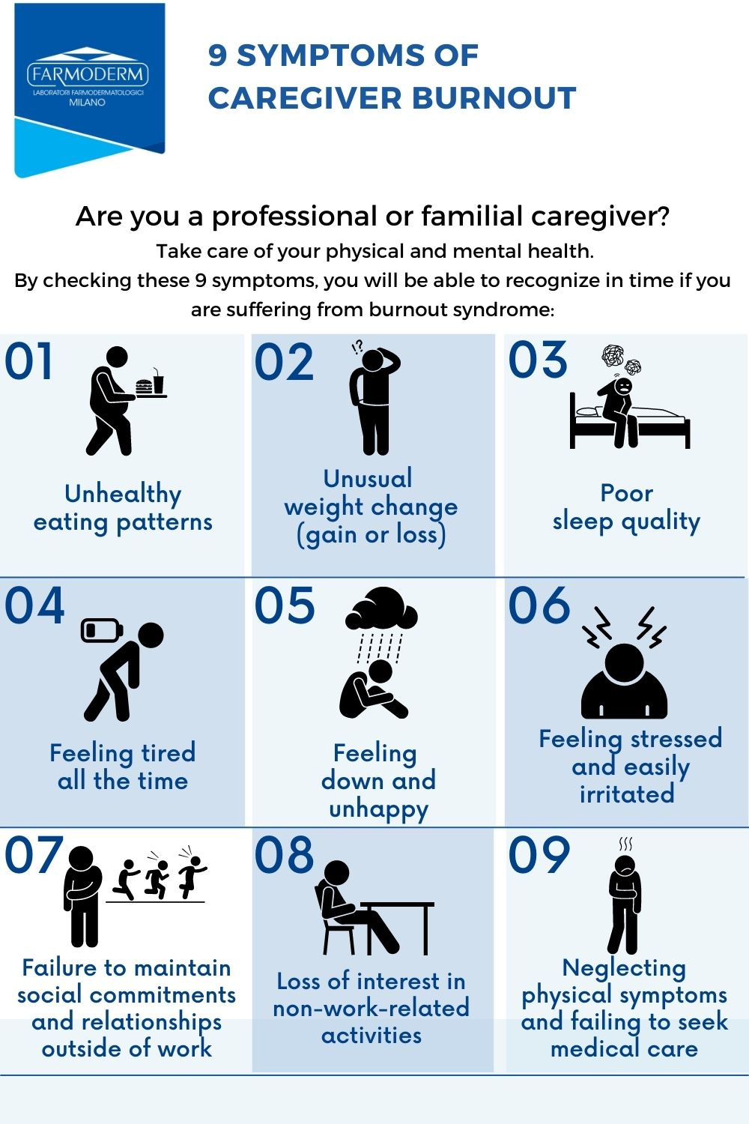

Slide 11
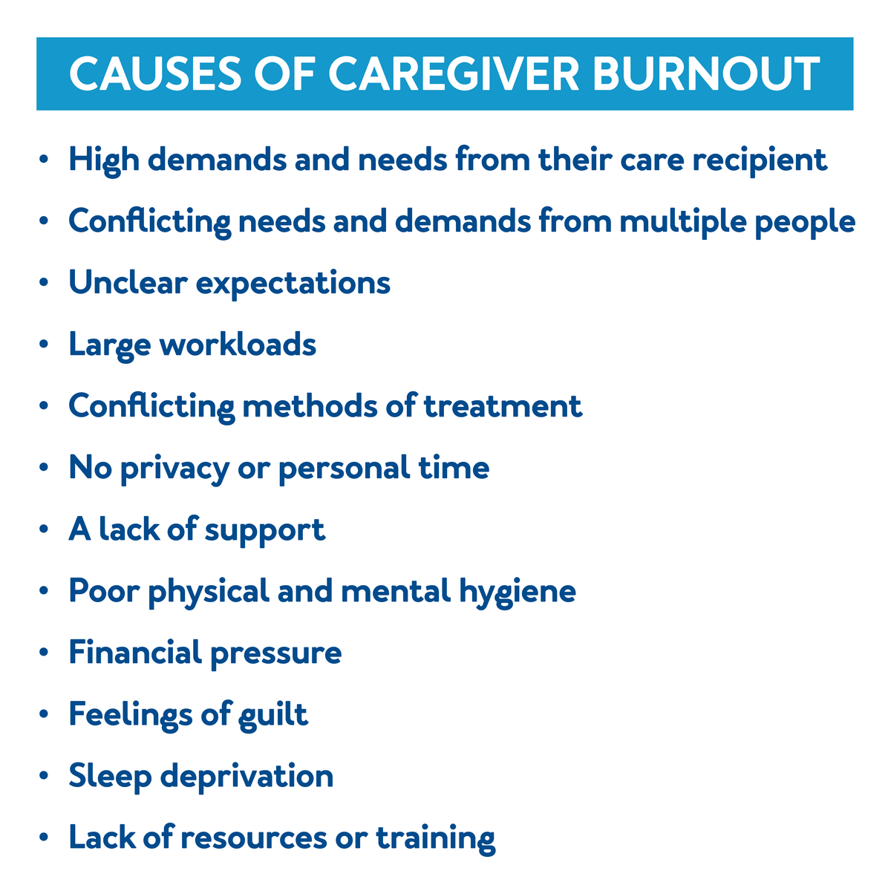

Slide 13
Tips to Manage Stress
Visualization
Meditation
Breathing exercises
Progressive muscle relaxation
Exercise
Gratitude List
Positive Self-Talk

Slide 14
Reasons To Do Activities
Feel more:
Energized
Calm
Centered
In touch with self
Connected with
Person with dementia
Community
Family
Friends
Enjoy the activity
Helps with sleep
Learn something
Add something to life
New experience
Something different
Enjoy time with others

Slide 15
Building a “Time-for-Yourself” Repertoire
What would you do if you found yourself with:
15 minutes of free time?
An hour of free time?
Three hours of free time?
A whole day?
A whole weekend free of caregiving responsibilities?

Slide 16
Asking for Help
Be direct and specific
Keep a list of things people can help you with
If they say no, ask someone else
Find community resources and care options

Slide 18
Our next speaker…
Rachel A. Weinstein, M.S. Ed.
Community Outreach and Caregiver Coalition Coordinator
ElderSource

Slide 19
Understanding Caregiver Grief and Ways to Cope
Rachel A. Weinstein, M.S. Ed.

Slide 20
Grief is…
A natural and normal response to any loss or change in something or someone important to us.

Slide 21
Grief impacts us in MANY ways…
INTELLECTUAL
EMOTIONAL
SOCIAL
PHYSICAL
SPIRITUAL

Slide 22
Types of grief
Ambiguous: Grieving the person who is “there” but “not there”
Anticipatory: Grieving a loss before it happens
Disenfranchised: not acknowledged in one’s circle/culture
Complicated/Prolonged (persists over time with undiminished strength and causing considerable loss of everyday functioning)
Delayed: Gap in time between our loss and our experience of grief

Slide 23
Ambiguous Loss

Slide 24
Coping with Ambiguous Loss 1. Name and normalize it 2. Practice both/and thinking 3. Know your “family” and community support systems. 4. Continue—but revise—family holidays, celebrations, and rituals 5. Revise family roles as needed 6. Control what you can and release struggle over what you can’t 7. Understand that anger and guilt are normal but avoid harmful actions. 8. Lean into what brings meaning/purpose in your life 9. Tend to your own health/wellness

Slide 25
Consult a physician or counselor if you…
Feel depressed, physically sick, or hopeless.
Feel like hurting yourself or hurting or yelling at the person you care for.
Depend too heavily on alcohol or recreational drugs.
Fight with your spouse, children, stepchildren, or other family members and friends.
No longer take care of yourself.

Slide 26
When you are a caregiver for someone with memory loss, the stress of ambiguity adds to the usual pressures of caregiving.
You have a duty and a right to take care of yourself.

Slide 27
Self-care is an important part of caring for your loved one.
2 Exercises:
Identifying your support system
Using your 5 senses for self-comfort

Slide 28
Know who your “people” are for support.

Slide 29
Self comfort is so important.

Slide 30
Self-care is not an act of selfishness.
When we are kind and generous with ourselves, we can pour kindness and love into others.
-Anita Ojeda

Slide 31
Be good to yourself. Thank you!

Slide 32
Our next speakers:
Cari Eyre, Dementia Director
Jessica Emick, Care Navigator

Slide 33
Florida’s Alzheimer’s and Related Dementia Infrastructure
Notes:
Anne: intro and overview, up to slide 6 – role of DOEA
Cari: DOEA programs through FACE,
Anne: SHIP - end

Slide 34
Overview
Florida prevalence
DOEA milestones
DOEA current programs
Florida Alzheimer’s Center of Excellence
State Health Improvement Plan

Slide 35
Florida’s Prevalence of Alzheimer’s
Approximately 580,000 Floridians live with AD.
Florida has the second highest prevalence of AD
By 2025, projected that there will be 720,000 Floridians with AD
African Americans are 2x likely as their white counterparts to develop AD
Hispanics are 1.5x as likely

Slide 36
Role of DOEA
Responsible for administering the human services and long-term care programs
Secretary Michelle Branham, appointed in December, 2021.

Slide 38
Respite Services in Florida
The Alzheimer’s Disease Initiative.
- Supportive services such as counseling, consumable medical supplies, respite care
- MDCs to diagnose, educate, train, and conduct research, treatment and referrals
- Florida Brain Bank
Community Care for the Elderly
Provides community-based services organized on a continuum of care to help functionally impaired elders live in the least restrictive, yet most cost-effective environment that suits their needs.

Slide 39
Resources in Florida
Memory Disorder Clinics
State-funded, statutorily-established to conduct research and training in a diagnostic and therapeutic setting for PLWD.

Slide 40
Resources in Florida
Area Agencies on Aging
Serves seniors and individuals with disabilities in the community.
The gateway to senior services – all intake assessments for HCBS such as ADI and CCE.

Slide 41
Resources in Florida
Dementia Care and Cure Initiative
Engage communities across Florida to be more dementia-caring, promote better care for Floridians affected by dementia, and support research efforts to find a cure.

Slide 42
Alzheimer’s Disease Advisory Committee
“The Committee shall advise the Department regarding legislature, programmatic, and administrative matters that relate to persons with Alzheimer’s disease and their caretaker.”
Source: F.S. 430.501

Slide 43
Florida Alzheimer’s Center of Excellence
(FACE)
Announced by Governor DeSantis on June 23, 2022

Slide 44
Phase I
Connect family caregivers to DOEA’s Care Navigators who support caregivers throughout the journey, making referrals, adjusting care plans, and offering emotional support

Slide 45
Care Navigators
Serve as regional experts, referring to programs offered by the state and community partners
800.96.ELDER

Slide 46
Care Navigators
Are regional experts. They engage with DCCI task forces, local Chapters of the Alzheimer’s Association and others to stay informed and make recommendations.

Slide 47
Peer Review
Challenging cases are elevated to ADAC for Peer Review

Slide 48
Phase II
Acknowledge sites that demonstrate excellence in in ADRD care and staff performance
(coming 2023)

Slide 49
State Health Improvement Plan Alzheimer’s Disease & Related Dementias

Slide 50
Overview
2022 Highlights
Goals and Objectives
Discussion and Questions

Slide 51
2021 – 2022 SHIP Highlights
Alzheimer's disease and related dementias (ADRD) Resource Guide
Caregiver Toolkit
Social and Economic Conditions Impacting Health (SECIH) added as a new priority area within SHIP
Notes:
Resource guides
- SHIP created and distributed ADRD specific resource guides. One on brain health, early detection and diagnosis. One solely for ADRD caregivers featuring resources and tips on issues such as dressing, and dealing with sundowning.

Slide 52
Goals and Objectives for ADRD 2022-2026
Notes:
The kick-off for SHIP started July 1, 2022; however, the ADRD PAW has created three surveys(outreach, training, caregiver), currently updating the resource guide and caregiver toolkit.

Slide 53
Goal AD1
Strengthen the capacity to address Alzheimer’s Disease and related dementias in Florida.
Notes:
Importance - Florida has the second highest prevalence of Alzheimer’s Disease in the United States with over 580,000 individuals living with a diagnosis. Florida’s numbers are expected to increase by over 24 percent by 2025.
Impact - Through our ADRD SHIP Priority impact, we will continue to enhance and increase our dementia capable infrastructure within the state to provide education, and awareness and to enhance the quality of life for our aging population.

Slide 54
Goal AD2
Ensure a competent Alzheimer’s disease and related dementias workforce.
Notes:
Importance - With the increasing number of Floridians living with the disease and their families, we must ensure a competent workforce to provide the best quality of care in our state.
Impact - In this, we look to enhance workforce development and training across all private and public sectors. We will target long-term care in Florida knowing that direct care workers are the single most important determinant of quality dementia care. Nationally, over 48 percent of individuals in long-term care communities are living with some form of ADRD. In Florida, these numbers are significantly higher at around 60 percent. With the continued increase in senior population retiring in Florida and the obstacles faced in the workforce, ensuring an adequately staffed and trained healthcare workforce is critical.

Slide 55
Goal AD3
Enhance support for those living with Alzheimer’s Disease and related dementias and their caregivers.
Notes:
Importance – In Florida, there are over 527,000 individuals in the state of Florida providing unpaid care to those living with ADRD. This totals over 685 million hours of unpaid care each year at a cost of 10.6 billion dollars. Caregivers also suffer from their own health conditions. Alzheimer’s is a disease that not only affects the individual but also has a tremendous impact on the family.
Impact – It is critical that we work to promote comprehensive care planning after a diagnosis. This gives not only the individual diagnosed an ability to make their wishes known but also gives caregivers the support structure they need throughout their caregiving journey. We need a dual approach that not only meets the health needs of the individual diagnosed but also the caregiver. In Florida, just over 48 percent of ADRD caregivers are managing their own chronic health condition (diabetes, heart disease, etc). Also, over 16 percent of ADRD caregivers have been diagnosed with clinical depression. We must not only address the physical health needs of caregivers but their mental health as well. Nationally, 70 percent of total lifetime cost of caring for someone with dementia is borne by the families. This is either through out-of-pocket health and long-term care expenses or from the value of unpaid care.

Slide 58
Questions?
Thank you!
Contact:
Cari Eyre
Eyrec@elderaffairs.org
Jessica Emick
emickj@elderaffairs.org
800.96.ELDER

Slide 59
Next… Conversation with a caregiver. Jeanette S.

Slide 60
Speaker Panel Q&A

Slide 61
Panel Discussion

Slide 62
Thank you for joining us today. Please enjoy lunch and visit the vendors.

